Slide 1
HTML Forms with ASP.NET

Slide 2
Mr. M.R. Solanki
Sr. Lecturer, Information Technology,
manish_ratilal2002@yahoo.com
SBMP

Slide 3
Learning Outcomes
Students will be able to:
Use ASP.NET validators in the web pages

Slide 4
function chkEmail()
{
var email = document.getElementById("<%= EmailID.ClientID %>").value;
var emailExp = /^([a-zA-Z0-9_\.\-])+\@(([a-zA-Z0-9\-])+\.)+([com\co\.\in])+$/;
if (!email.match(emailExp))
{
alert("Invalid Email Id");
return false;
}
}
/^([a-zA-Z0-9_\.\-])+\@(([a-zA-Z0-9\-])+\.)+([com\co\.\in])+$/;
OR
/^([a-zA-Z0-9_\.\-])+\@(([a-zA-Z0-9\-])+\.)+([a-zA-Z]{2,5})+$/;

Slide 5
ASP.NET Validators

Slide 6
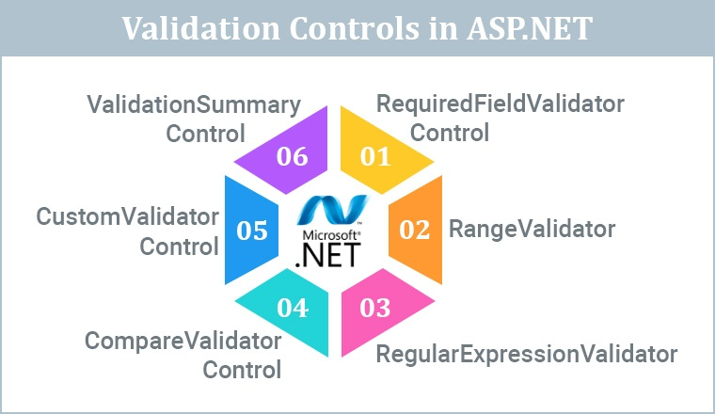
https://www.tatvasoft.com/outsourcing/2022/09/validation-in-asp-net.html

Slide 7
Why do we need Validation?
Preventing invalid data from being submitted: Validation controls can check for required fields, format and type of data, and other criteria that must be met before the data can be submitted to the server. This helps ensure that the data is accurate and complete and that the application can process it correctly.
Improving user experience: When users enter invalid data, they may receive error messages or other feedback that helps them correct their mistakes. This can help prevent frustration and improve the overall user experience.
Enhancing security: Validation controls can help prevent malicious code or other attacks that could harm the web application or its users. For example, validation controls can check for potentially dangerous input such as SQL injection or cross-site scripting (XSS) attacks.
Meeting business requirements: Many businesses have specific rules and requirements for data entry, such as a minimum or a maximum number of characters or certain formatting conventions. Validation controls can help ensure that these requirements are met.
https://www.c-sharpcorner.com/UploadFile/puranindia/validation-controls-in-Asp-Net/

Slide 8
ASP.NET Validators
To perform validation, ASP.NET provides controls that automatically check user input and require no code. We can also create custom validation for our application.
Validator | Description
CompareValidator | It is used to compare the value of an input control against a value of another input control. Password: Confirm Password:
RangeValidator | It evaluates the value of an input control to check the specified range. Sem 1-8, Age: 14-18
RegularExpressionValidator | It evaluates the value of an input control to determine whether it matches a pattern defined by a regular expression. Email, passwords
RequiredFieldValidator | It is used to make a control required. In Every control * Required Field
ValidationSummary | It displays a list of all validation errors on the Web page.

Slide 9
Validation Control | Description
RequiredFieldValidation | Ensures that a field is not left empty or blank. It can be used for textboxes, dropdown lists, checkboxes, and other input controls.
CompareValidator | This control compares the value of one input control to another. It can validate passwords, confirm email addresses, and other scenarios where two values must match.
RangeValidator | This control checks if a value falls within a specific range. For example, it can be used to validate a user's age, income, or date of birth.
RegularExpressionValidator | This control checks if a value matches a specified regular expression pattern. For example, it can validate email addresses, phone numbers, zip codes, and other input types.
CustomValidator | This control allows developers to define their validation logic. It usually depends on the business rules.
ValidationSummary | This control displays a report of all validation errors that occurred on a Web page.
https://www.c-sharpcorner.com/UploadFile/puranindia/validation-controls-in-Asp-Net/

Slide 10
ASP.NET Validators
1. RequiredFieldValidator
Indicates the input Control is not empty when the form is submitted.
Syntax
<asp:RequiredFieldValidator ID="someUniqueId"
runat="server" ControlToValidate ="someUniqueControlId"
ErrorMessage="ErrorToDisplayOnValidationFailure"
InitialValue="aPlaceholderValue">
</asp:RequiredFieldValidator>
ControlToValidate= id of control we want to monitor/validate
NOTE: In DropDown List, InitialValue attribute should be written before ErrorMessage attribute

Slide 11
ASP.NET Validators
2. RangeValidator
The Rangevalidator control verifies that the input value falls within a given range of number, date or string.
Syntax
<asp:RangeValidator ID="some unique id"
runat="server" ControlToValidate ="someUniqueControlId"
ErrorMessage="ErrorToDisplayOnValidationFailure"
Type="Integer" MinimumValue=”0” MaximumValue=”100”>
</asp:RangeValidator>

Slide 12
ASP.NET Validators
3. RegularExpressionValidator
The RegularExpressionValidator control validates the input text of a control that matches a pattern defined by a RegularExpression.
Syntax
<asp:RegularExpressionValidator ID="someUniqueId"
runat="server" ControlToValidate ="someUniqueControlId"
ErrorMessage="ErrorToDisplayOnValidationFailure"
ValidationExpression=”aRegexPattern”>
</asp:RegularExpressionValidator>

Slide 13
ASP.NET Validators
4. CompareValidator
The Comaprevalidator control compares the value of one control to another using a comparison operator.
Syntax
<asp:CompareValidator ID="someUniqueId"
runat="server" ControlToValidate ="someUniqueControlId"
ErrorMessage="ErrorToDisplayOnValidationFailure"
Type="string" ControlToCompare=”ControlToValidateIdOfAnotherControl”
ValueToCompare=”aFixedValue” Operator=”Equal”>
</asp:CompareValidator>

Slide 14
ASP.NET Validators
5. CustomValidator
ASP.Net also allows the freedom of writing your own validator. This eases the task of a developer to validate the form at the client side itself. It also allows putting more complex validations in place. Validations that are business or application-specific can be written using custom validators.
Syntax
<asp:CustomValidator ID="someUniqueId"
runat="server" ControlToValidate ="someUniqueControlId"
ErrorMessage="ErrorToDisplayOnValidationFailure"
ClientValidationFunction=”functionName”>
</asp:CustomValidator>

Slide 15
ASP.NET Validators
6. ValidationSummary
The ValidationSummary control doesn’t perform any validation. Instead, it shows a summary of errors raised by each control on the page.
Syntax
<asp:ValidationSummary ID="ValidationSummaryControl"
runat="server" DisplayMode=”BulletList” ShowSummary=”true”
HeaderText=”List of Errors” />
Reference -> https://rlogicaltech.medium.com/what-are-asp-net-validators-7990b53aaead

Slide 16
<%@ Page Language="C#" AutoEventWireup="true" CodeBehind="Validators.aspx.cs" Inherits="WebApplication1.WebForm2" %>
<!DOCTYPE html>
<html xmlns="http://www.w3.org/1999/xhtml">
<head runat="server">
<title></title>
</head>
<body>
<form id="form1" runat="server">
<table style="width: 66%;">
<tr>
<td class="style1" colspan="3" align="center">
<asp:Label ID="lblmsg"
Text="President Election Form : Choose your president"
runat="server" />
</td>
</tr>
<tr>
<td class="style3">
Candidate:
</td>
<td class="style2">
<asp:DropDownList ID="ddlcandidate" runat="server" style="width:239px">
<asp:ListItem>Please choose a candidate</asp:ListItem>
<asp:ListItem>M H Kabir</asp:ListItem>
<asp:ListItem>Steve Taylor</asp:ListItem>
<asp:ListItem>John Abraham</asp:ListItem>
<asp:ListItem>Venus Williams</asp:ListItem>
</asp:DropDownList>
</td>

Slide 17
<td>
<asp:RequiredFieldValidator ID="rfvcandidate"
runat="server" ControlToValidate ="ddlcandidate"
InitialValue="Please choose a candidate"
ErrorMessage="Please choose a candidate"
ForeColor="Red">
</asp:RequiredFieldValidator>
</td>
</tr>
<tr>
<td class="style3">
House:
</td>
<td class="style2">
<asp:RadioButtonList ID="rblhouse" runat="server" RepeatLayout="Flow">
<asp:ListItem>Red</asp:ListItem>
<asp:ListItem>Blue</asp:ListItem>
<asp:ListItem>Yellow</asp:ListItem>
<asp:ListItem>Green</asp:ListItem>
</asp:RadioButtonList>
</td>

Slide 18
<td>
<asp:RequiredFieldValidator ID="rfvhouse" runat="server"
ControlToValidate="rblhouse" ErrorMessage="Enter your house name" ForeColor="Red" >
</asp:RequiredFieldValidator>
<br />
</td>
</tr>
<tr>
<td class="style3">
Class:
</td>
<td class="style2">
<asp:TextBox ID="txtclass" runat="server"></asp:TextBox>
</td>
<td>
<asp:RangeValidator ID="rvclass"
runat="server" ControlToValidate="txtclass"
ErrorMessage="Enter your class (6 - 12)" MaximumValue="12"
MinimumValue="6" Type="Integer" ForeColor="Red">
</asp:RangeValidator>
</td>
</tr>

Slide 19
<tr>
<td class="style3">
Email:
</td>
<td class="style2">
<asp:TextBox ID="txtemail" runat="server" style="width:250px">
</asp:TextBox>
</td>
<td>
<asp:RegularExpressionValidator ID="remail" runat="server"
ControlToValidate="txtemail" ErrorMessage="Enter your email"
ForeColor="Red" ValidationExpression="\w+([-+.']\w+)*@\w+([-.]\w+)*\.\w+([-.]\w+)*">
</asp:RegularExpressionValidator>
</td>
</tr>
<tr>
<td class="style3" align="center" colspan="3">
<asp:Button ID="BtnSubmit" runat="server" onclick="BtnSubmit_Click"
style="text-align: center" Text="Submit" />
</td>
</tr>
</table>
<asp:ValidationSummary ID="ValidationSummary1" runat="server"
DisplayMode ="BulletList" ShowSummary ="true" HeaderText="Errors:" ForeColor="Red" />
</form>
</body>
</html>

Slide 20
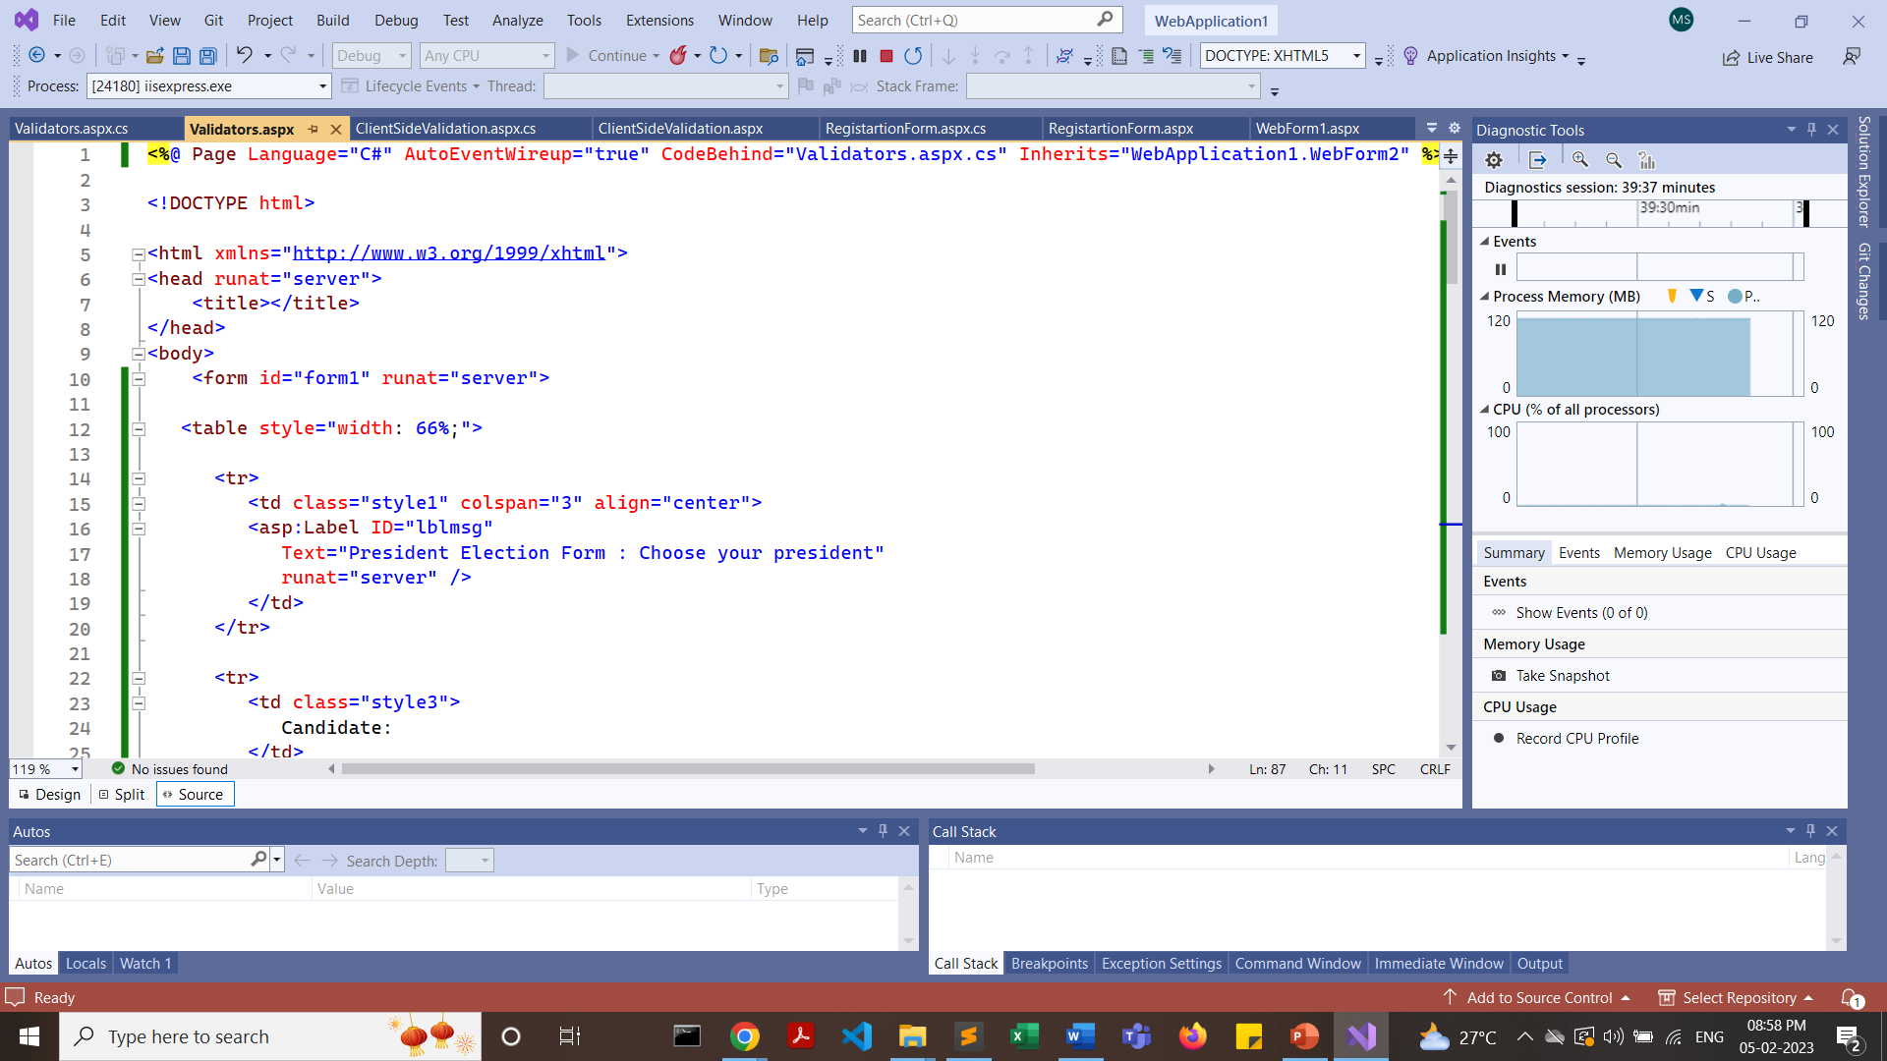

Slide 21
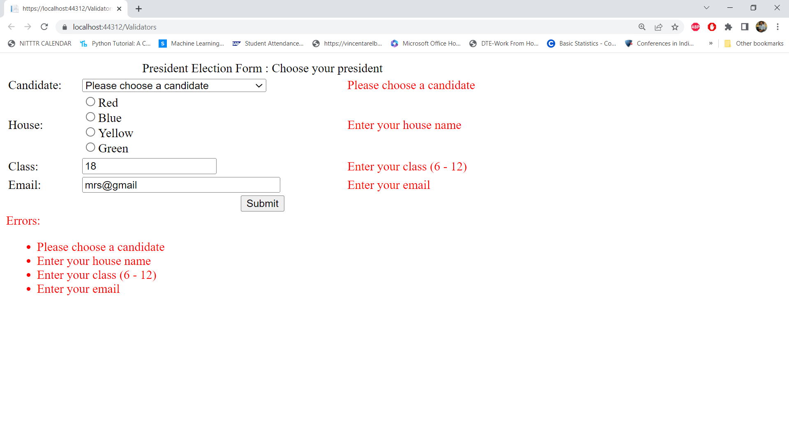
https://www.tutorialspoint.com/asp.net/asp.net_validators.htm

Slide 22
#ControlToValidate property is mandatory for all validate controls #One validation control will validate only one input control, but multiple validation control can be assigned to the input control.

Slide 23
Another Application

Slide 24
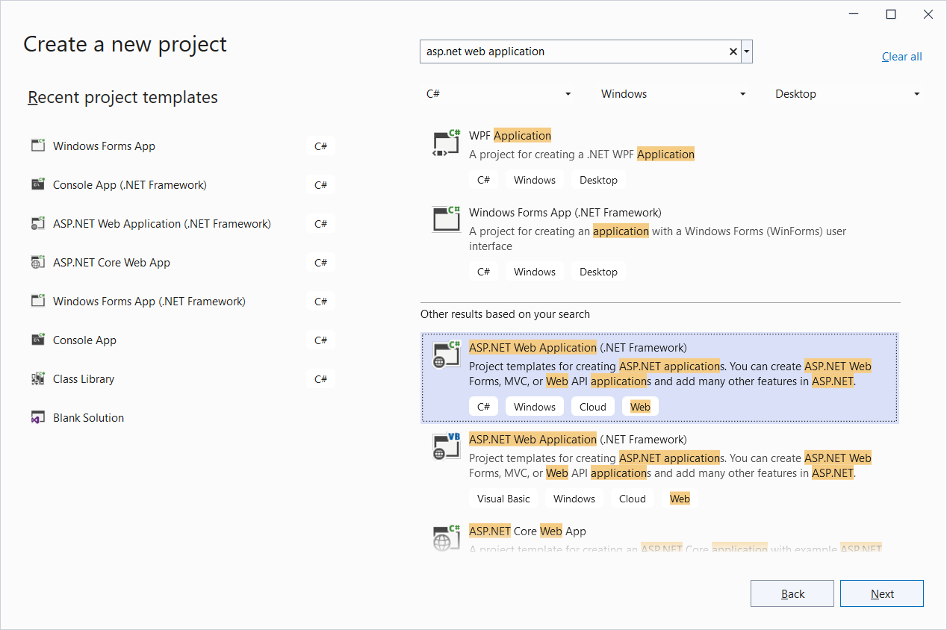

Slide 25
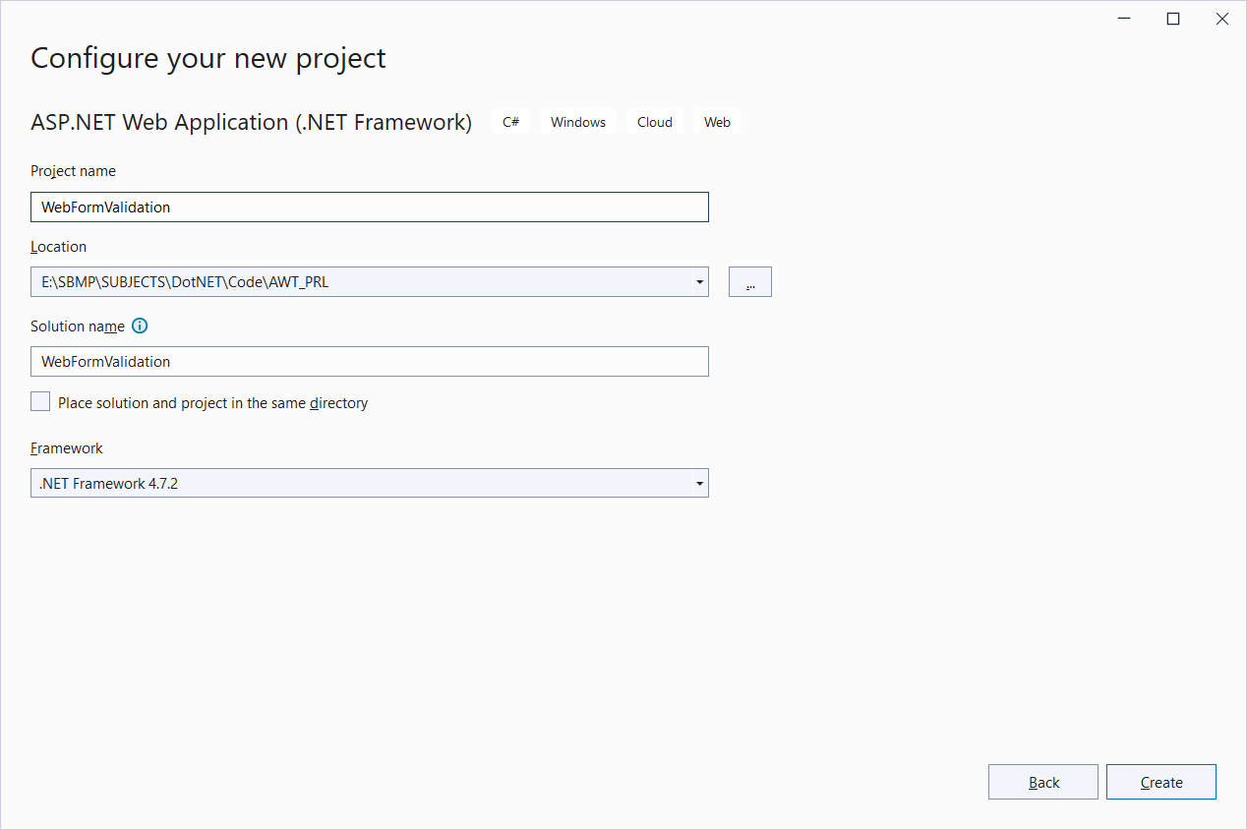

Slide 26
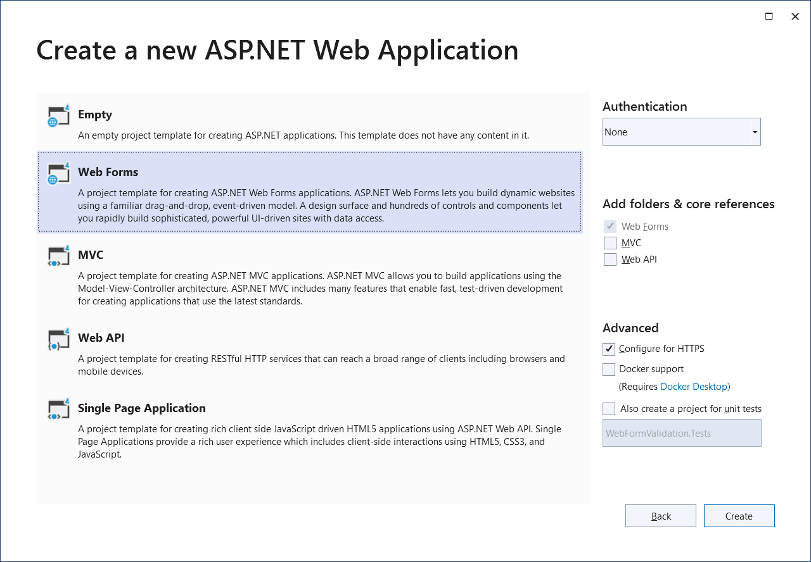

Slide 27
Default.aspx code
<%@ Page Language="C#" AutoEventWireup="true" CodeFile="Default.aspx.cs" Inherits=“namespace._Default" %>
<!DOCTYPE html PUBLIC "-//W3C//DTD XHTML 1.0 Transitional//EN" "http://www.w3.org/TR/xhtml1/DTD/xhtml1-transitional.dtd">
<html xmlns="http://www.w3.org/1999/xhtml">
<head runat="server">
<title>Untitled Page</title>
</head>
<body>
<form id="form1" runat="server">
<div>
<asp:Label ID="Label3" runat="server" Style="top: 241px; left: 70px; position: absolute;
height: 22px; width: 128px; bottom: 282px;" Text="Enter your email id:"></asp:Label>
<asp:Label ID="Label1" runat="server" Style="top: 54px; left: 74px; position: absolute;
height: 22px; width: 128px" Text="Enter your name:"></asp:Label>
<asp:TextBox ID="TextBox1" runat="server" Style="top: 54px; left: 221px; position: absolute;
height: 22px; width: 128px; right: 396px;"></asp:TextBox>
<asp:RequiredFieldValidator ID="RequiredFieldValidator1" runat="server" Style="top: 56px;
left: 378px; position: absolute; height: 22px; width: 128px" ErrorMessage="RequiredFieldValidator"
ControlToValidate="TextBox1">name is
mandatory </asp:RequiredFieldValidator>
</div>

Slide 28
<p>
<asp:Button ID="Button1" runat="server" Style="top: 311px; left: 267px; position: absolute;
height: 26px; width: 61px" Text="Submit" />
</p>
<asp:TextBox ID="TextBox3" runat="server" Style="top: 145px; left: 217px; position: absolute;
height: 22px; width: 131px" TextMode="Password"></asp:TextBox>
<p>
<asp:TextBox ID="TextBox2" runat="server" Style="top: 101px; left: 218px; position: absolute;
height: 22px; width: 131px" TextMode="Password"></asp:TextBox>
<asp:Label ID="Label4" runat="server" Style="top: 105px; left: 74px; position: absolute;
height: 22px; width: 128px" Text="Password"></asp:Label>
<asp:TextBox ID="TextBox5" runat="server" Style="top: 239px; left: 210px; position: absolute;
height: 22px; width: 134px"></asp:TextBox>
</p>
<asp:RequiredFieldValidator ID="RequiredFieldValidator3" runat="server" Style="top: 98px;
left: 367px; position: absolute; height: 26px; width: 162px" ErrorMessage="password required"
ControlToValidate="TextBox2"></asp:RequiredFieldValidator>
<asp:RequiredFieldValidator ID="RequiredFieldValidator2" runat="server" Style="top: 145px;
left: 367px; position: absolute; height: 26px; width: 162px" ErrorMessage="password required"
ControlToValidate="TextBox3"></asp:RequiredFieldValidator>
<asp:CompareValidator ID="CompareValidator1" runat="server" Style="top: 149px; left: 512px;
position: absolute; height: 26px; width: 162px" ErrorMessage="CompareValidator"
ControlToValidate="TextBox3" ValueToCompare="hello"></asp:CompareValidator>

Slide 29
<p>
<asp:Label ID="Label5" runat="server" Style="top: 148px; left: 71px; position: absolute;
height: 22px; width: 128px; bottom: 375px;" Text="Confirm Password"></asp:Label>
<asp:TextBox ID="TextBox4" runat="server" Style="top: 194px; left: 212px; position: absolute;
height: 22px; width: 140px"></asp:TextBox>
<asp:Label ID="Label6" runat="server" Style="top: 194px; left: 71px; position: absolute;
height: 22px; width: 128px; bottom: 329px;" Text="Enter your age:"></asp:Label>
</p>
<asp:RangeValidator ID="RangeValidator1" runat="server" Style="top: 194px; left: 365px;
position: absolute; height: 22px; width: 105px" ErrorMessage="RangeValidator"
ControlToValidate="TextBox4" MaximumValue="100" MinimumValue="18" Type="Integer"></asp:RangeValidator>
<asp:RegularExpressionValidator ID="RegularExpressionValidator1" runat="server" Style="top: 234px;
left: 366px; position: absolute; height: 22px; width: 177px"
ErrorMessage="RegularExpressionValidator" ControlToValidate="TextBox5"
ValidationExpression="\w+([-+.']\w+)*@\w+([-.]\w+)*\.\w+([-.]\w+)*"></asp:RegularExpressionValidator>
</form>
</body>
</html>

Slide 30
<%@ Page Language="C#" AutoEventWireup="true" CodeFile="Default.aspx.cs" Inherits="WebFormValidation._Default" %>
If CodeFile=“Default.aspx.cs” then Inherits property value should be “WebAppName._Default”
Namespace._Default

Slide 31
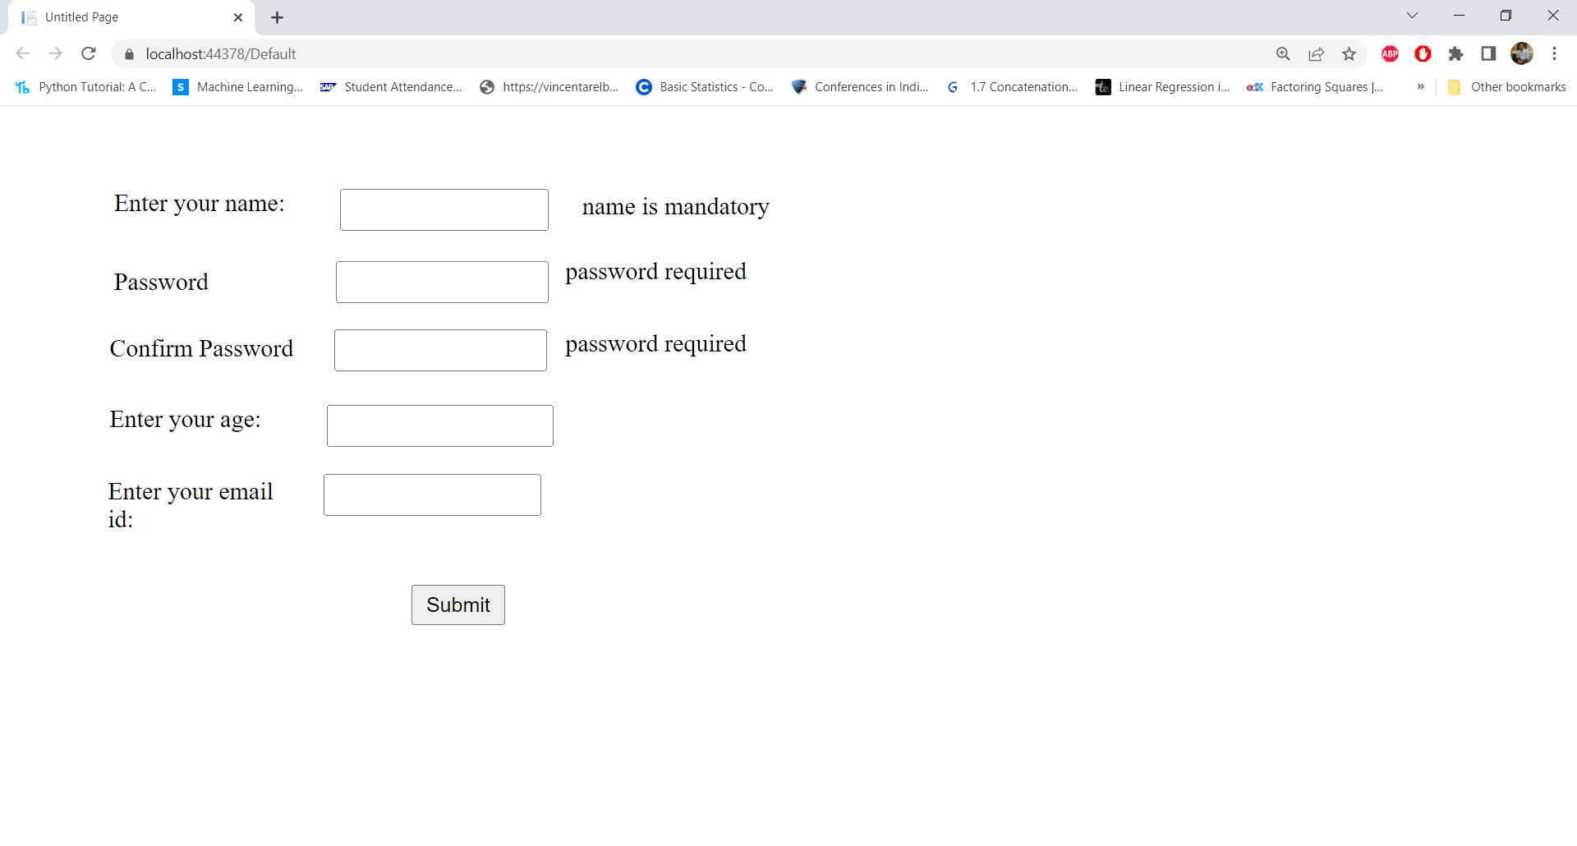

Slide 32
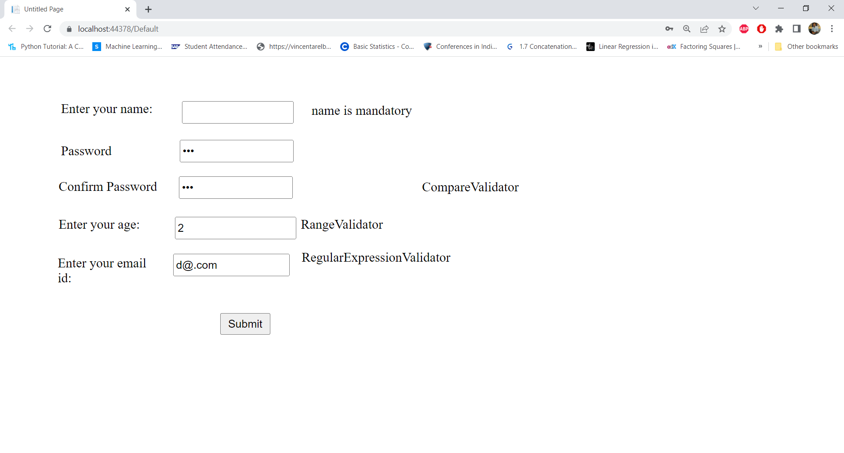

Slide 33
Custom Validator

Slide 34
<%@ Page Language="C#" AutoEventWireup="true" CodeBehind="CustomValidator.aspx.cs" Inherits="WebApplication1.CustomValidator" %>
<!DOCTYPE html>
<html xmlns="http://www.w3.org/1999/xhtml">
<head runat="server">
<title></title>
</head>
<body>
<form id="form1" runat="server">
<div>
<asp:Label ID="Label1" runat="server" Text="User ID:"></asp:Label>
<asp:TextBox ID="TextBox1" runat="server"></asp:TextBox>
<asp:RequiredFieldValidator ID="RequiredFieldValidator1" runat="server"
ControlToValidate="TextBox1" ErrorMessage="User id required"></asp:RequiredFieldValidator>
<asp:CustomValidator ID="CustomValidator1" runat="server" OnServerValidate="UserCustomValidate"
ControlToValidate="TextBox1"
ErrorMessage="User ID should have atleast a capital, small and digit and should be greater than 5 and less
than 26 letters"
SetFocusOnError="True"></asp:CustomValidator>
</div>
<asp:Button ID="Button1" runat="server" OnClick="Button1_Click" Text="Submit"></asp:Button>
</form>
</body>
</html>

Slide 35
Create a method “UserCustomValidate()” in C# as shown below:
protected void UserCustomValidate(object source, ServerValidateEventArgs args)
{
string str = args.Value;
args.IsValid = false;
//checking for input length greater than 6 and less than 25 characters
if (str.Length < 6 || str.Length > 25)
{
return;
}
//checking for a atleast a single capital letter
bool capital = false;
foreach (char ch in str)
{
if (ch >= 'A' && ch <= 'Z')
{
capital = true;
break;
}
}
if (!capital)
{
return;
}

Slide 36
//checking for a atleast a single lower letter
bool lower = false;
foreach (char ch in str)
{
if (ch >= 'a' && ch <= 'z')
{
lower = true;
break;
}
}
if (!lower)
{
return;
}
bool digit = false;
foreach (char ch in str)
{
if (ch >= '0' && ch <= '9')
{
digit = true;
break;
}
}
if (!digit)
{
return;
}
args.IsValid = true;
} //end of UserCustomValidate method

Slide 37
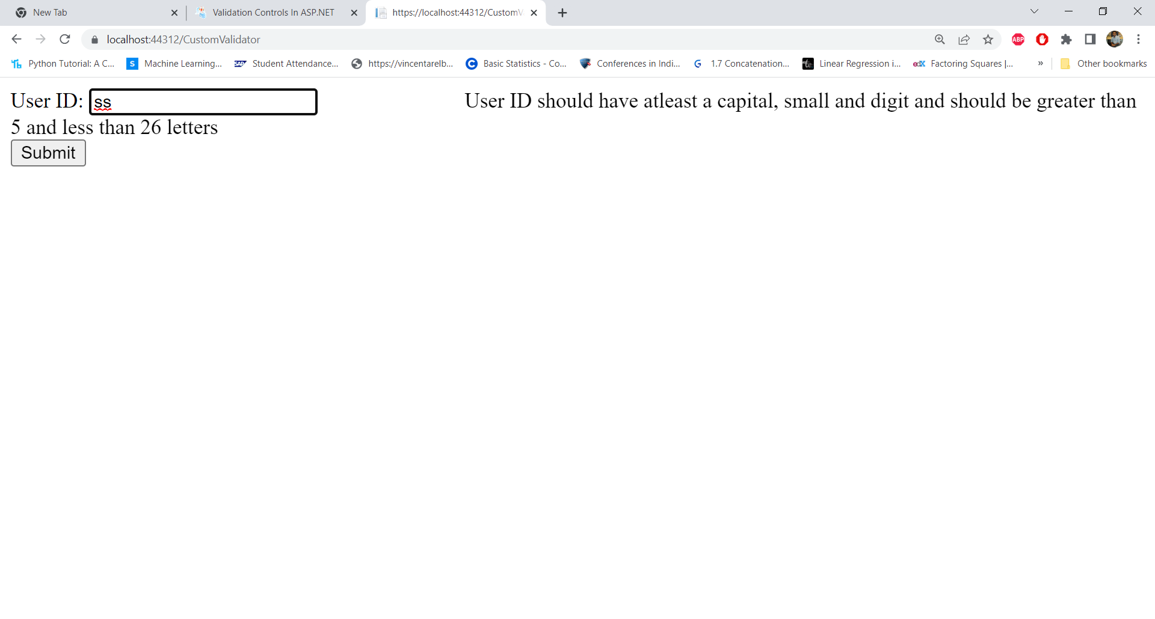

Slide 38
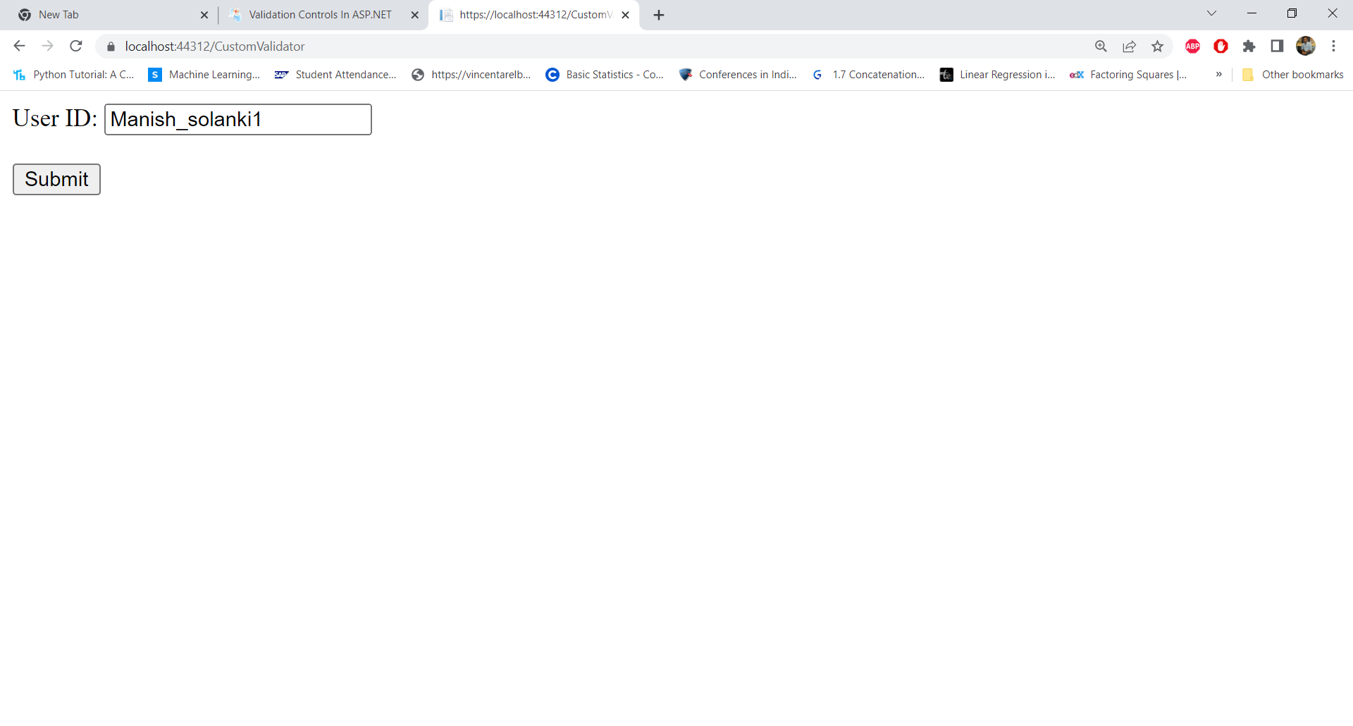

Slide 39
Renaming a Web Form

Slide 40
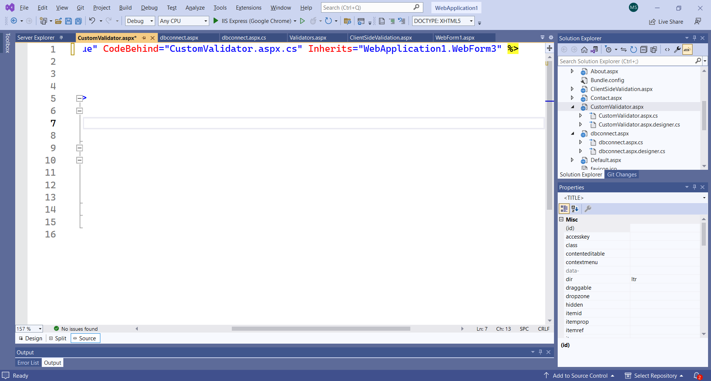
If we rename a WebForm, then changed name is not reflected inside .aspx file. Example: I renamed “WebForm3” to “CustomValidator” but Inherits property has not changed the name as shown below:
So, we have to change it explicitly:
Inherits="WebApplication1.CustomValidator"

Slide 41
We have to change the class name in .cs file as well
using System;
using System.Collections.Generic;
using System.Linq;
using System.Web;
using System.Web.UI;
using System.Web.UI.WebControls;
namespace WebApplication1
{
public partial class WebForm3 : System.Web.UI.Page
{
protected void Page_Load(object sender, EventArgs e)
{
}
}
}

Slide 42
We have to change the class name in .cs file as well
using System;
using System.Collections.Generic;
using System.Linq;
using System.Web;
using System.Web.UI;
using System.Web.UI.WebControls;
namespace WebApplication1
{
public partial class CustomValidator : System.Web.UI.Page
{
protected void Page_Load(object sender, EventArgs e)
{
}
}
}

Slide 43
Form Authentication

Slide 44
Create a new “Web application” Project i.e. “FormAuthentication” and select Empty Template

Slide 45
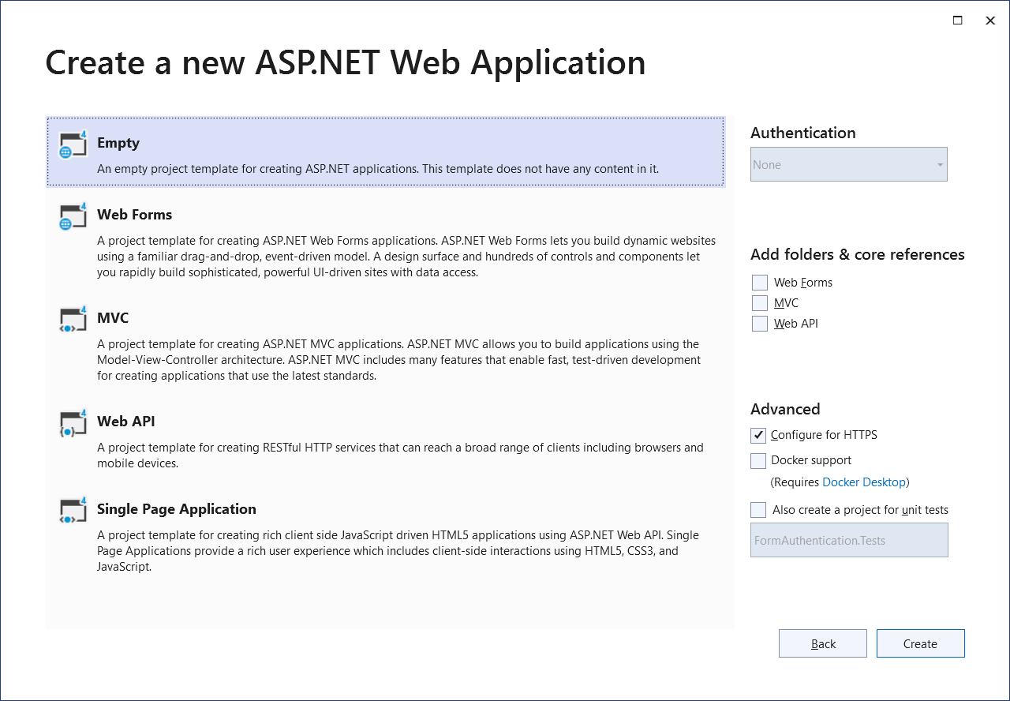

Slide 46
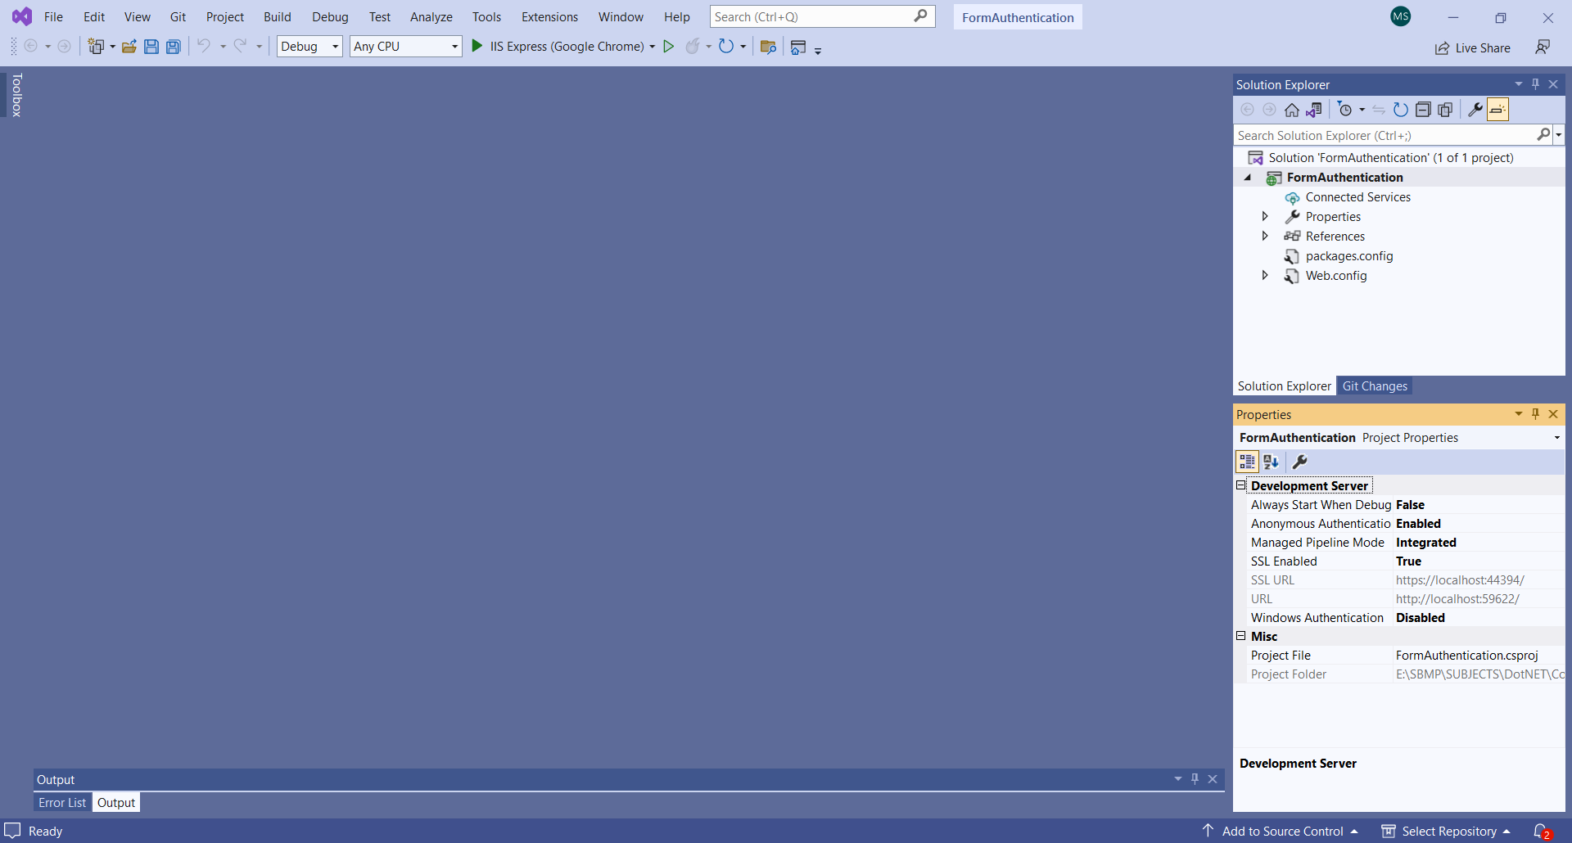

Slide 47
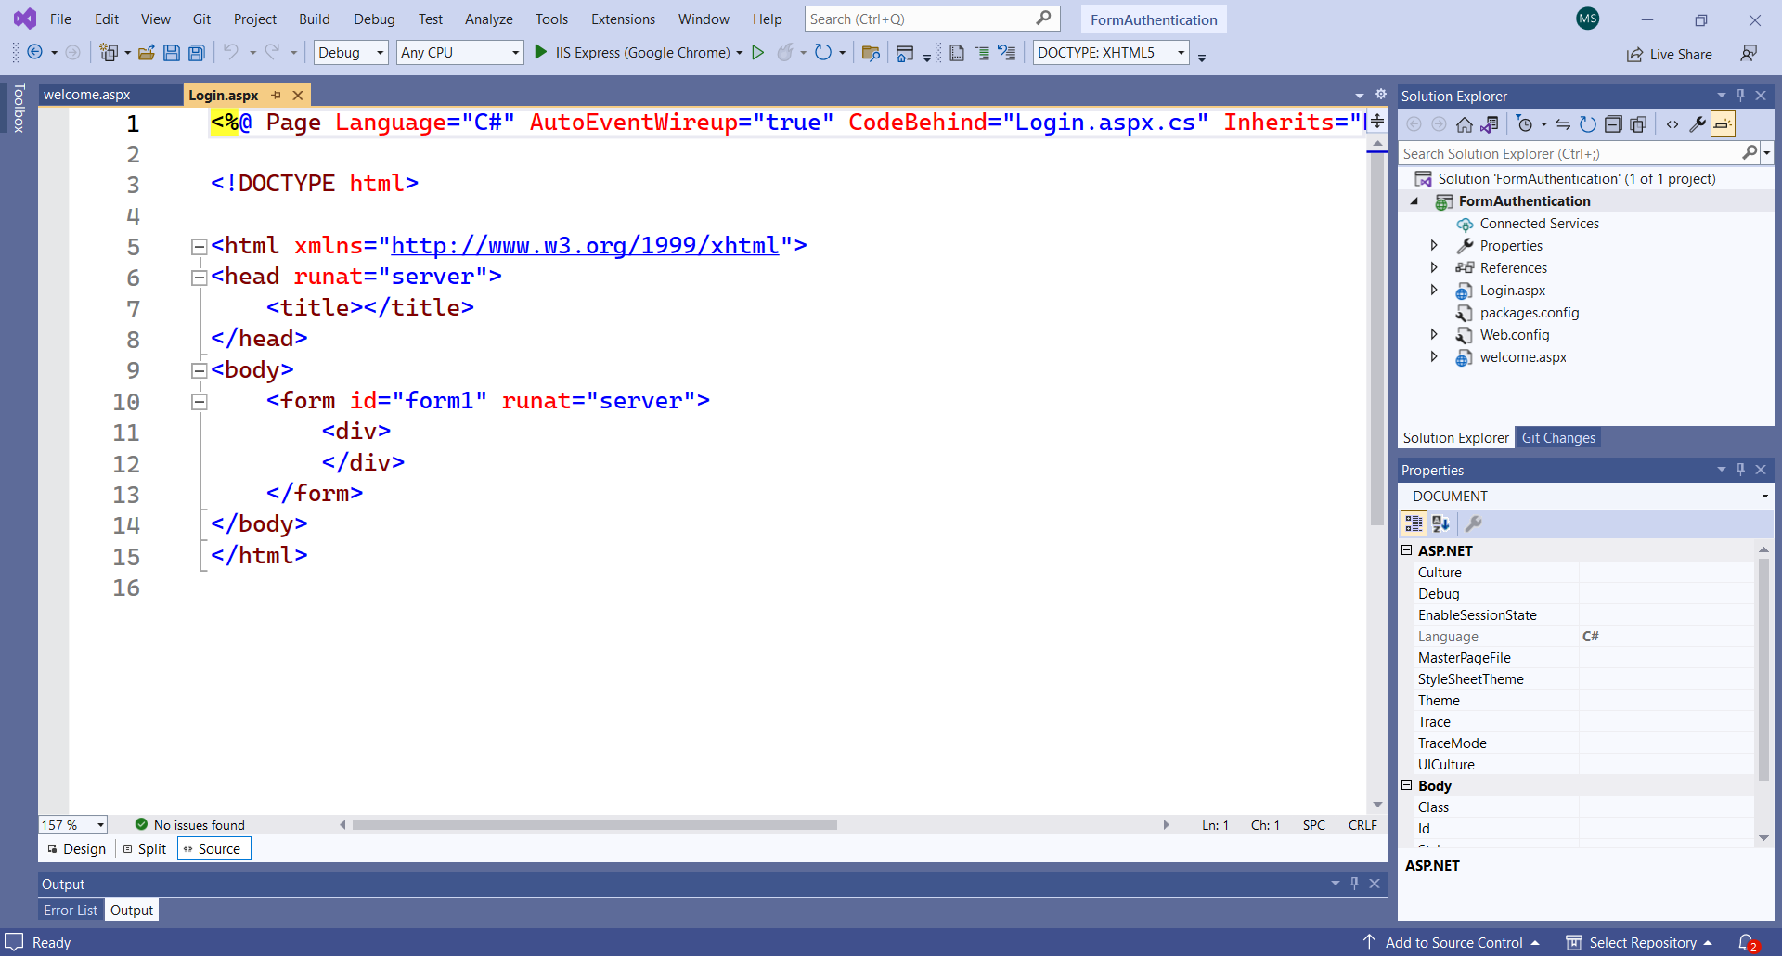
Add 2 web forms i.e. login.aspx and welcome.aspx

Slide 48
<!DOCTYPE html>
<html
xmlns="http://www.w3.org/1999/xhtml">
<head runat="server">
<title></title>
</head>
<body>
<form id="form1" runat="server">
<h3>
Login Page</h3>
<table>
<tr>
<td>
UserName:</td>
<td>
<asp:TextBox ID="UserName" runat="server" />
</td>
<td>
<asp:RequiredFieldValidator ID="RequiredFieldValidator1"
ControlToValidate="UserName"
Display="Dynamic"
ErrorMessage="Cannot be empty."
runat="server" />
</td>
</tr>

Slide 49
<tr>
<td>
Password:</td>
<td>
<asp:TextBox ID="UserPass" TextMode="Password"
runat="server" />
</td>
<td>
<asp:RequiredFieldValidator ID="RequiredFieldValidator2"
ControlToValidate="UserPass"
ErrorMessage="Cannot be empty."
runat="server" />
</td>
</tr>
<tr>
<td>
Remember me?</td>
<td>
<asp:CheckBox ID="chkboxPersist" runat="server" />
</td>
</tr>
</table>
<asp:Button ID="Submit1" OnClick="Login_Click" Text="Log In"
runat="server" />
<p>
<asp:Label ID="Msg" ForeColor="red" runat="server" />
</p>
</form>
</body>
</html>

Slide 50
protected Boolean Authenticate(String uname,String password)
{
if (uname.CompareTo("student")==0 && password.CompareTo("stu@123")==0)
return true;
return false;
}
protected void Login_Click(object sender, EventArgs e)
{
if (Authenticate(UserName.Text, UserPass.Text))
{
Response.Redirect("welcome.aspx");
Response.End();
}
else
{
Msg.Text = "Invalid User Name and/or Password";
}
}

Slide 51
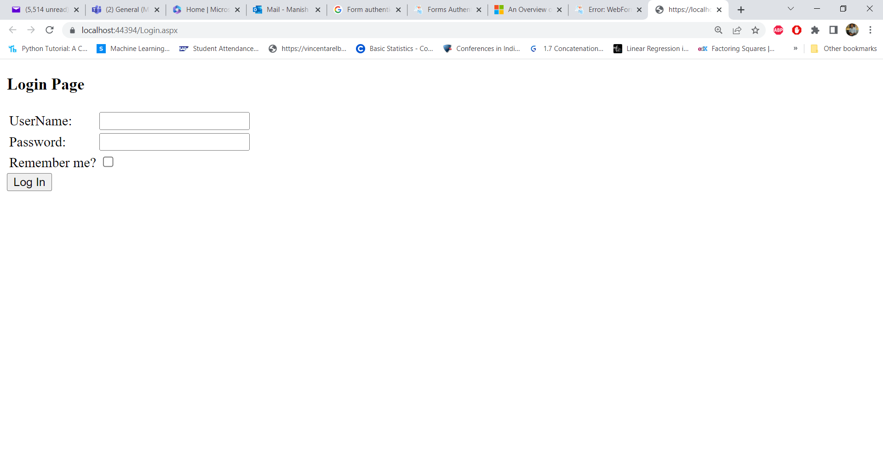

Slide 52
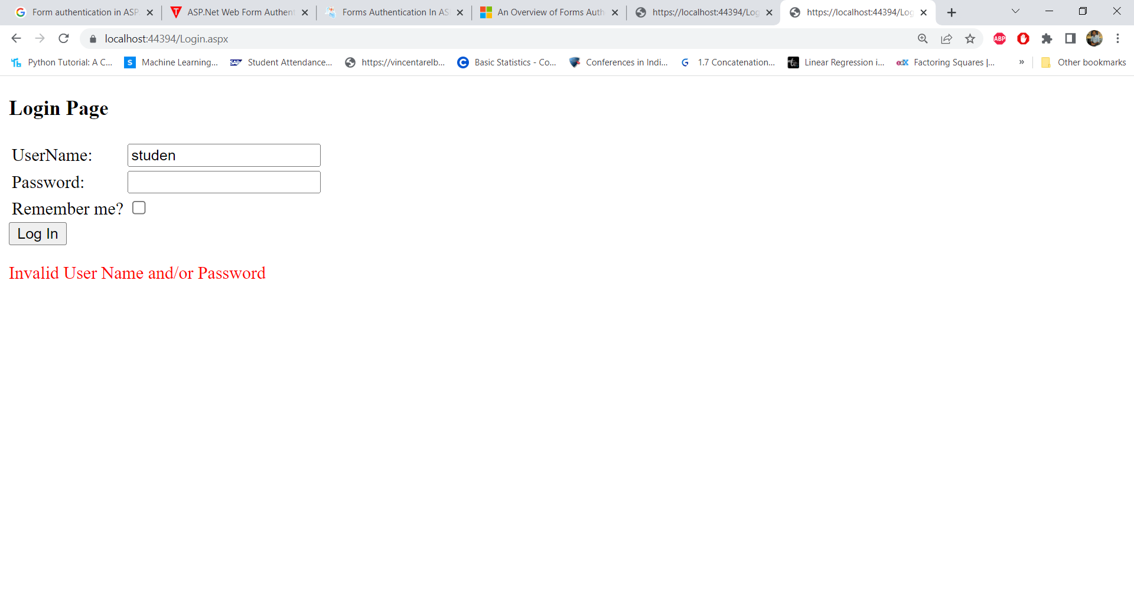
Invalid User

Slide 53
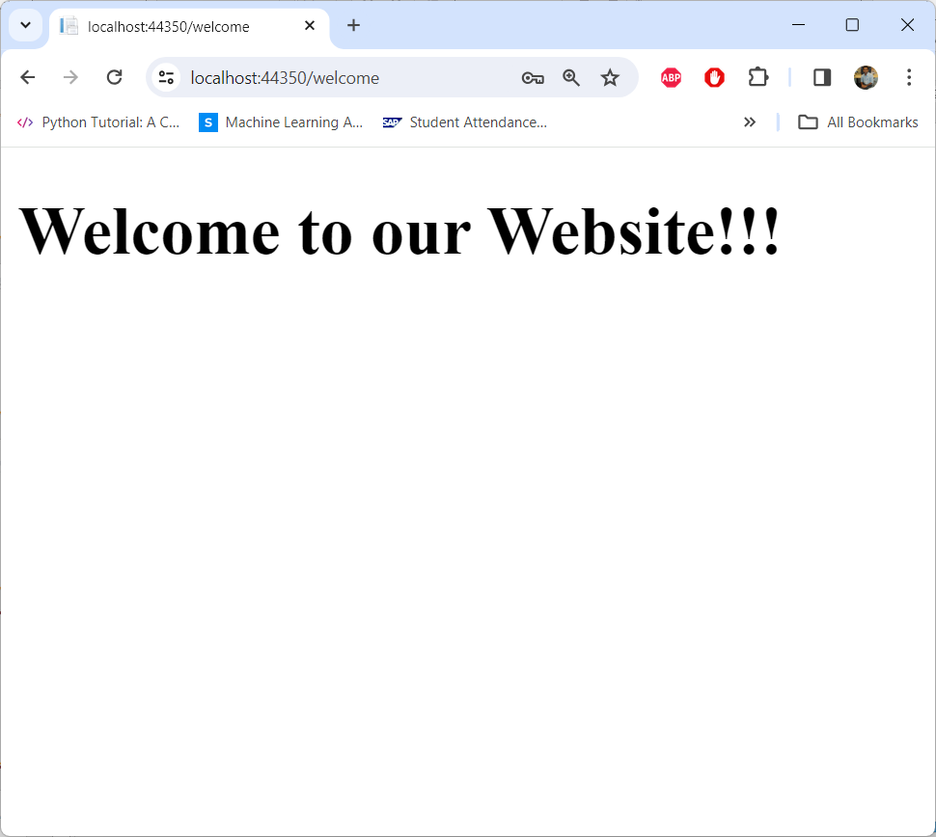

Slide 54
Another Code to authenticate user name & password
protected void LoginButton_Click(object sender, EventArgs e)
{ // Three valid username/password pairs: Scott/password, Jisun/password, and Sam/password.
string[] users = { "Scott", "Jisun", "Sam" };
string[] passwords = { "password", "password", "password" };
for (int i = 0; i < users.Length; i++)
{
bool validUsername = (string.Compare(UserName.Text, users[i], true) == 0);
bool validPassword = (string.Compare(Password.Text, passwords[i], false) == 0);
if (validUsername && validPassword) {
// TODO: Log in the user... // TODO: Redirect them to the appropriate page
} }
// true = non case sensitivity is enabled and false means disabled
// If we reach here, the user's credentials were invalid
InvalidCredentialsMessage.Visible = true; }
https://learn.microsoft.com/en-us/aspnet/web-forms/overview/older-versions-security/introduction/an-overview-of-forms-authentication-cs

Slide 55
using System;
namespace CsharpString {
class Test {
public static void Main(string [] args) {
string str1 = "Programiz";
string str2 = "programiz";
int result;
// compares str1 and str2
result = String.Compare(str1, str2);
Console.WriteLine(result);
Console.ReadLine();
}
}
}

Slide 56
Using web.config

Slide 57
Now we set web.config file to implement the authentication of web application.
<system.web>
<compilation debug="true" targetFramework="4.7.2" />
<authentication mode="Forms">
<forms loginUrl="login.aspx" defaultUrl="welcome.aspx">
<credentials passwordFormat="Clear">
<user name="student" password="stu@123"/>
<user name="faculty" password="fac@123" />
</credentials>
</forms>
</authentication>
<authorization>
<deny users="?"/>
</authorization>
<httpRuntime targetFramework="4.7.2" />
</system.web>

Slide 58
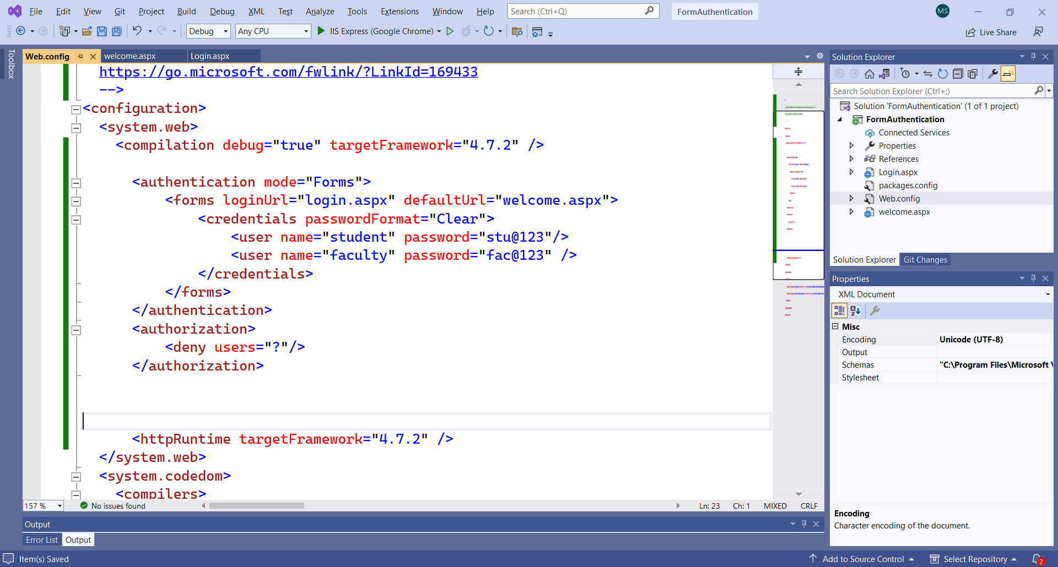

Slide 59
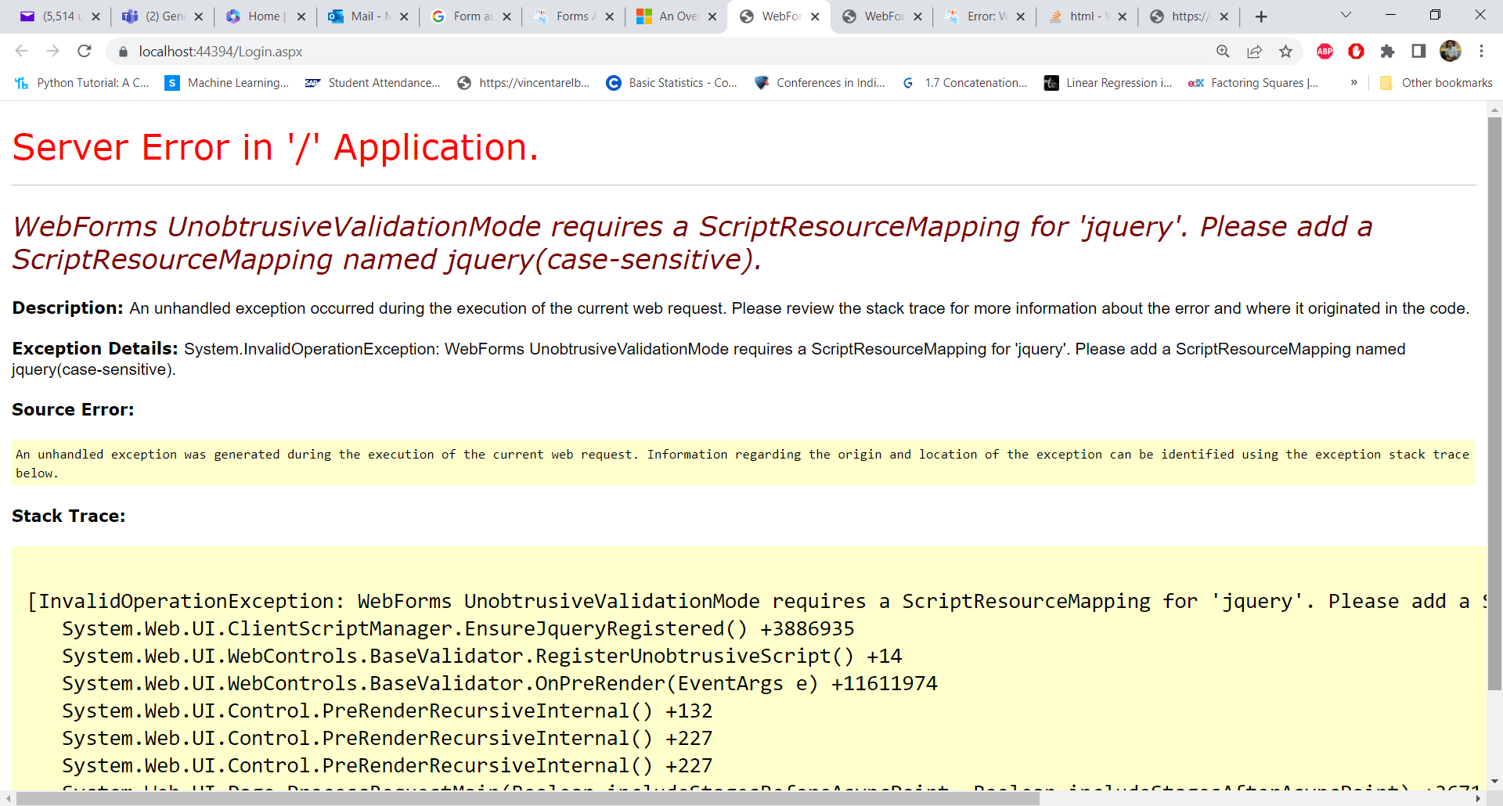
While running the login.aspx form, we will get an error of Event handling button and after providing that function we will get the following error

Slide 60
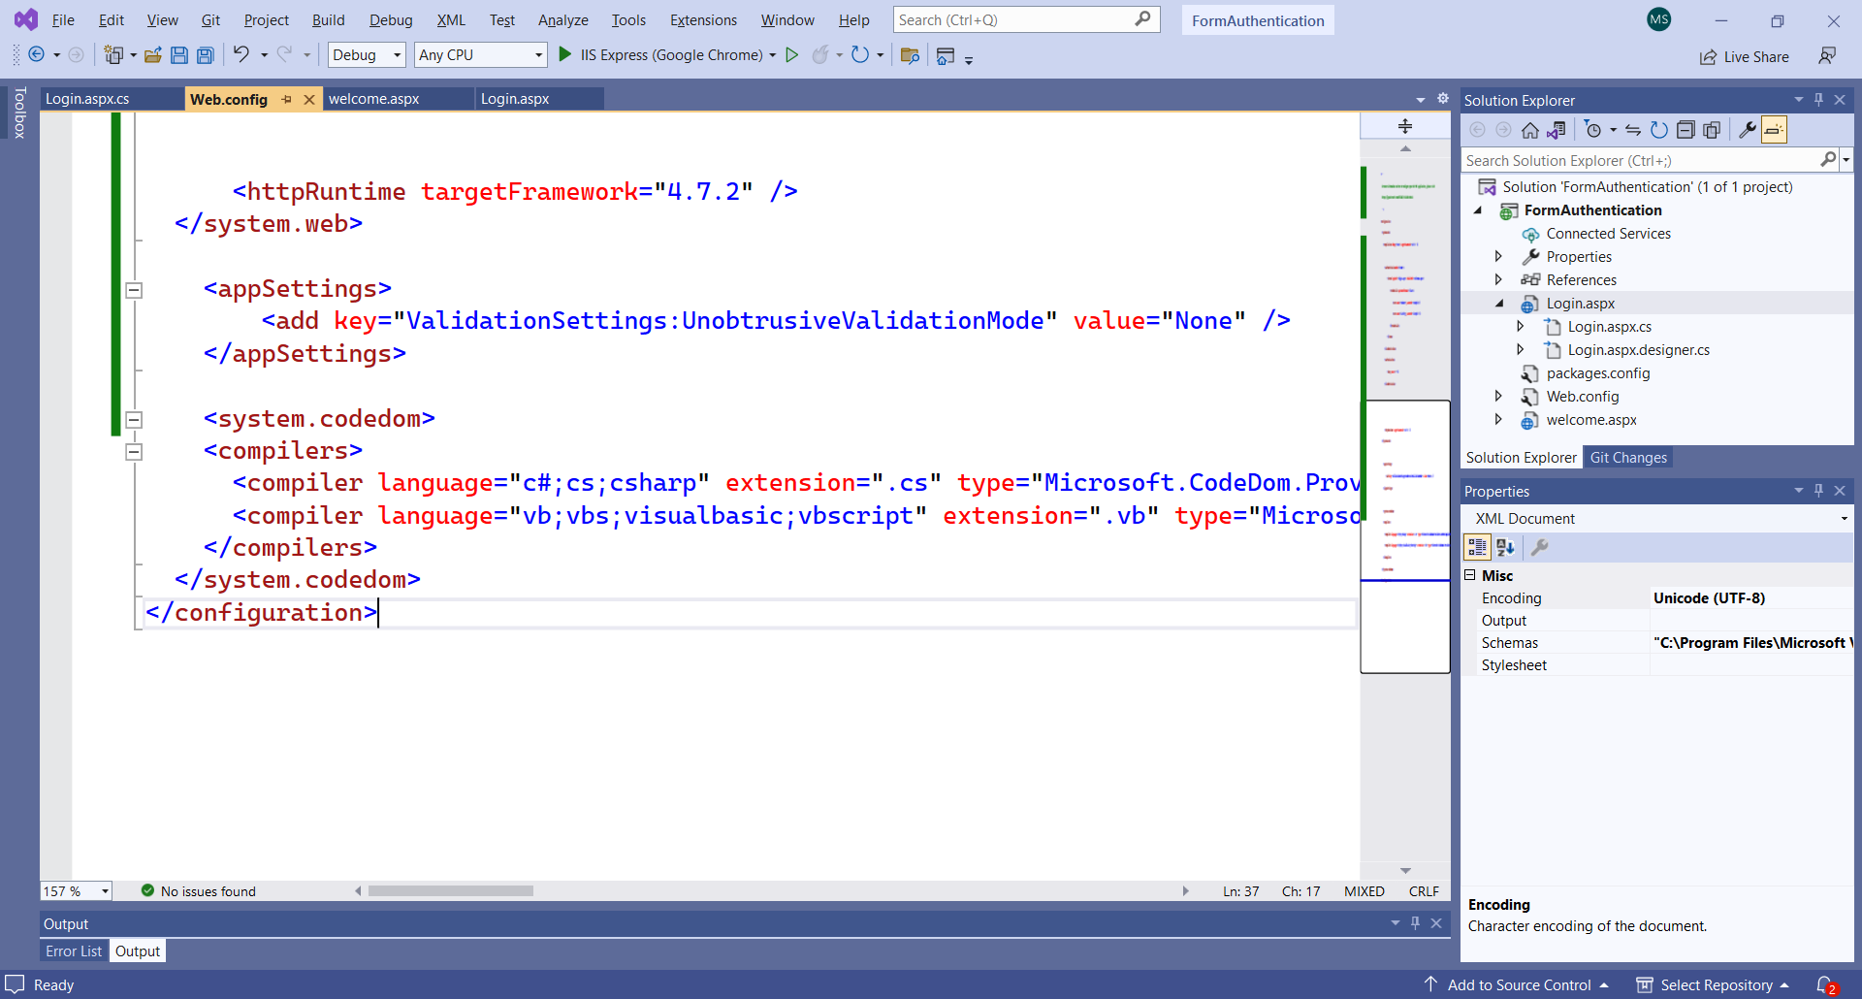
SOLUTION: Add the key in the web.config file
<appSettings>
<add key="ValidationSettings:UnobtrusiveValidationMode" value="None" />
</appSettings>
https://stackoverflow.com/questions/16660900/webforms-unobtrusivevalidationmode-requires-a-scriptresourcemapping-for-jquery

Slide 61
<system.web>
<compilation debug="true" targetFramework="4.7.2" />
<authentication mode="Forms">
<forms loginUrl="login.aspx" defaultUrl="welcome.aspx">
<credentials passwordFormat="Clear">
<user name="student" password="stu@123"/>
<user name="faculty" password="fac@123" />
</credentials>
</forms>
</authentication>
<authorization>
<deny users="?"/>
</authorization>
<httpRuntime targetFramework="4.7.2" />
</system.web>
<appSettings>
<add key="ValidationSettings:UnobtrusiveValidationMode" value="None" />
</appSettings>

Slide 62
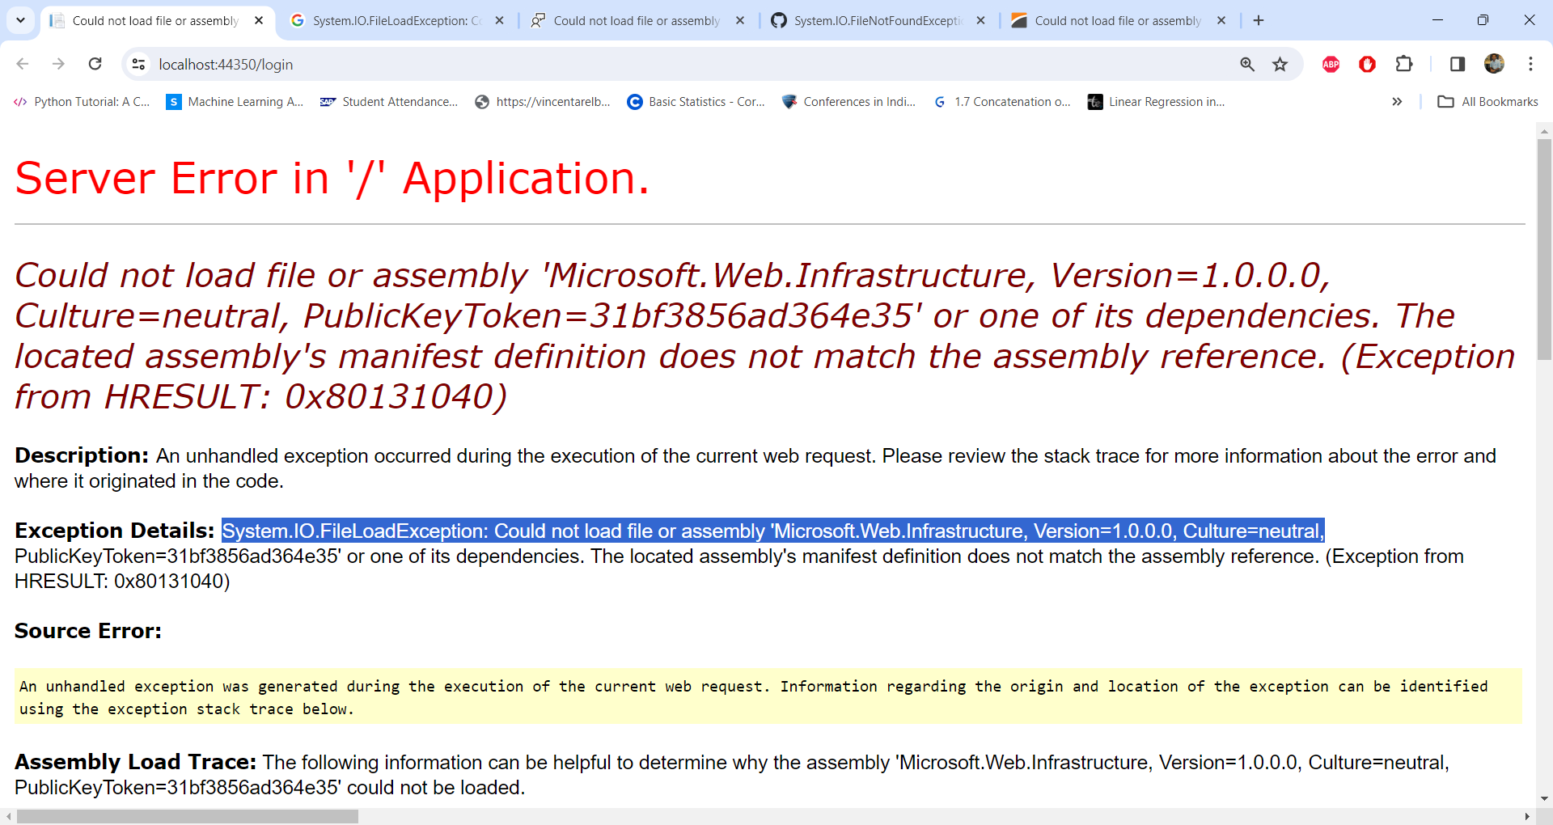
New ISSUE

Slide 63
Solution
Modify the web.config file to redirect the System.Web.Mvc assembly to the version installed on your machine.
<assemblyBinding xmlns="urn:schemas-microsoft-com:asm.v1"> <dependentAssembly> <assemblyIdentity name="System.Web.Mvc" publicKeyToken="31bf3856ad364e35" /> <bindingRedirect oldVersion="1.0.0.0-5.2.7.0" newVersion="5.2.7.0" /> </dependentAssembly> ... </assemblyBinding>
https://docs.devexpress.com/AspNetMvc/404543/troubleshooting/installation-and-update-issues/could-not-load-file-or-assembly-system-web-mvc

Slide 64
<httpRuntime targetFramework="4.7.2" />
</system.web>
<assemblyBinding xmlns="urn:schemas-microsoft-com:asm.v1">
<dependentAssembly>
<assemblyIdentity name="System.Web.Mvc" publicKeyToken="31bf3856ad364e35" />
<bindingRedirect oldVersion="1.0.0.0-5.2.7.0" newVersion="5.2.7.0" />
</dependentAssembly>
...
</assemblyBinding>
<appSettings>
<add key="ValidationSettings:UnobtrusiveValidationMode" value="None" />
</appSettings>
<system.codedom>
<compilers>
<compiler language="c#;cs;csharp" extension=".cs" type="Microsoft.CodeDom.Providers.DotNetCompilerPlatform.CSharpCodeProvider, Microsoft.CodeDom.Providers.DotNetCompilerPlatform, Version=2.0.1.0, Culture=neutral, PublicKeyToken=31bf3856ad364e35" warningLevel="4" compilerOptions="/langversion:default /nowarn:1659;1699;1701" />
<compiler language="vb;vbs;visualbasic;vbscript" extension=".vb" type="Microsoft.CodeDom.Providers.DotNetCompilerPlatform.VBCodeProvider, Microsoft.CodeDom.Providers.DotNetCompilerPlatform, Version=2.0.1.0, Culture=neutral, PublicKeyToken=31bf3856ad364e35" warningLevel="4" compilerOptions="/langversion:default /nowarn:41008 /define:_MYTYPE=\&quot;Web\&quot; /optionInfer+" />
</compilers>
</system.codedom>
</configuration>

Slide 65
protected void Login_Click(object sender, EventArgs e)
{
if (FormsAuthentication.Authenticate(UserName.Text, UserPass.Text))
{
FormsAuthentication.RedirectFromLoginPage(UserName.Text, chkboxPersist.Checked);
}
else
{
Msg.Text = "Invalid User Name and/or Password";
}
}

Slide 66
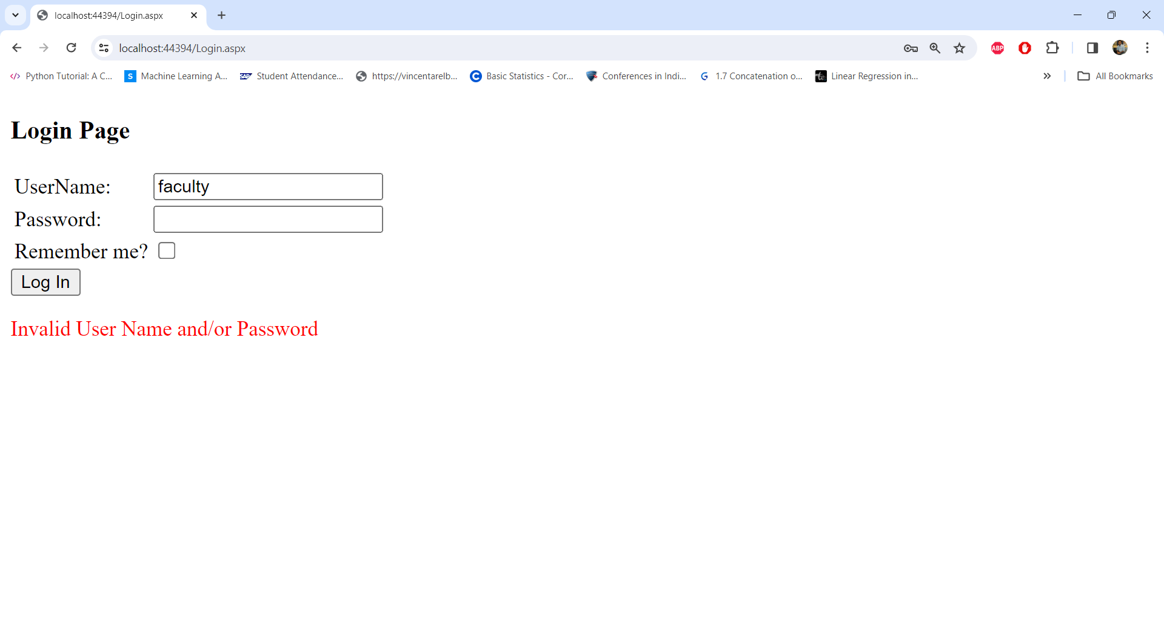

Slide 67
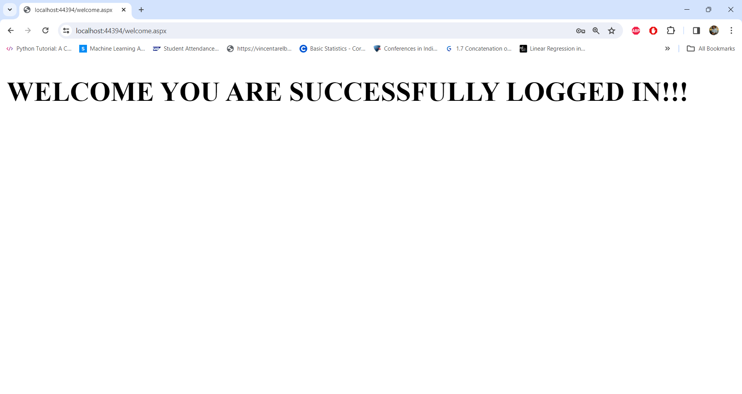

Slide 68
https://www.c-sharpcorner.com/UploadFile/fa9d0d/forms-authentication-in-Asp-Net/
https://learn.microsoft.com/en-us/aspnet/web-forms/overview/older-versions-security/introduction/an-overview-of-forms-authentication-cs
https://www.c-sharpcorner.com/UploadFile/sourabh_mishra1/sending-an-e-mail-using-Asp-Net-with-C-Sharp/
https://csharp-video-tutorials.blogspot.com/2012/12/forms-authentication-using-user-names.html

Slide 69
Thanks!
Any questions?
You can find me at:
manish_ratilal2002@yahoo.com

Slide 70
Credits
Client & Server Side Validation code
https://www.c-sharpcorner.com/article/textbox-validation-client-side-and-server-side-in-asp-net-webform/
Validation Controls & Custom Validators
https://www.c-sharpcorner.com/UploadFile/puranindia/validation-controls-in-Asp-Net/

